Slide 1
Status Report
2015. 12. 2
Nam Jong Woo

Slide 2
Action Item
Background Estimation
DYTauTau
ttbar
WJets
WW
WZ
ZZ
THStack Not yet…

Slide 3
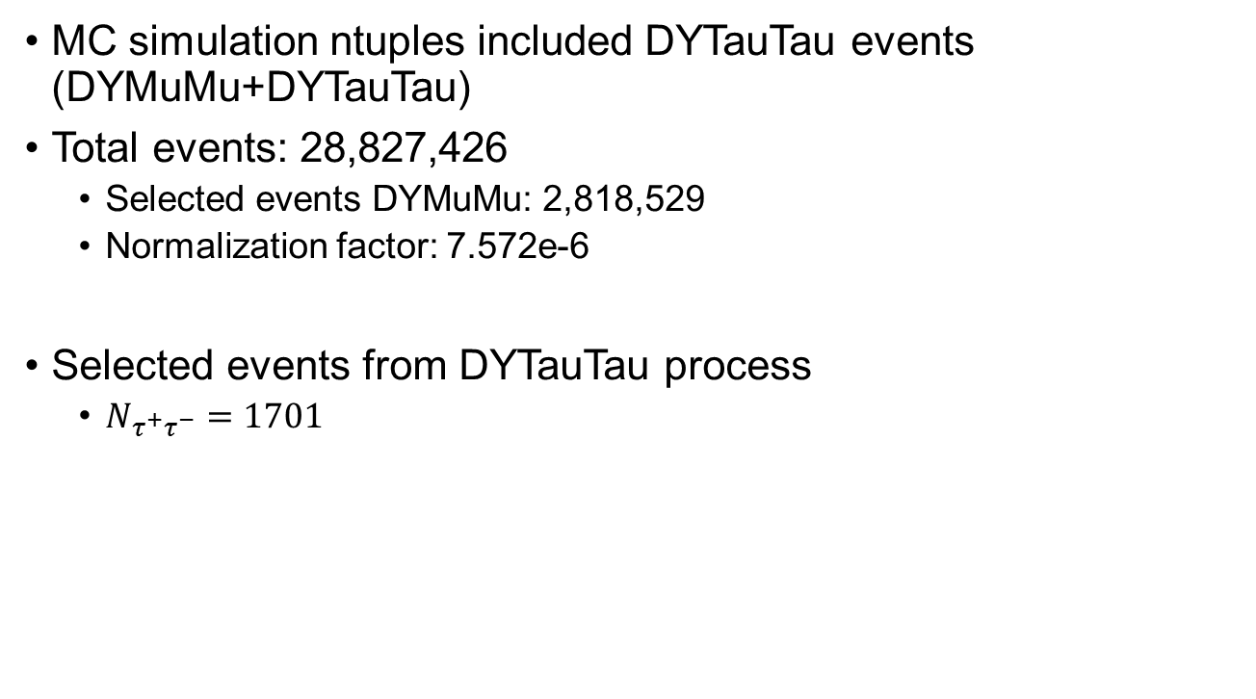
DYTauTau
MC simulation ntuples included DYTauTau events (DYMuMu+DYTauTau)
Total events: 28,827,426
Selected events DYMuMu: 2,818,529
Normalization factor: 7.572e-6
Selected events from DYTauTau process
$N_{τ^{+}τ^{−}}=1701$

Slide 4

ttbar
Total events: 19,900,300
Normalize factor: 0.172
Selected events from ttbar process
$N_{t\overline{t}}=41725$

Slide 5
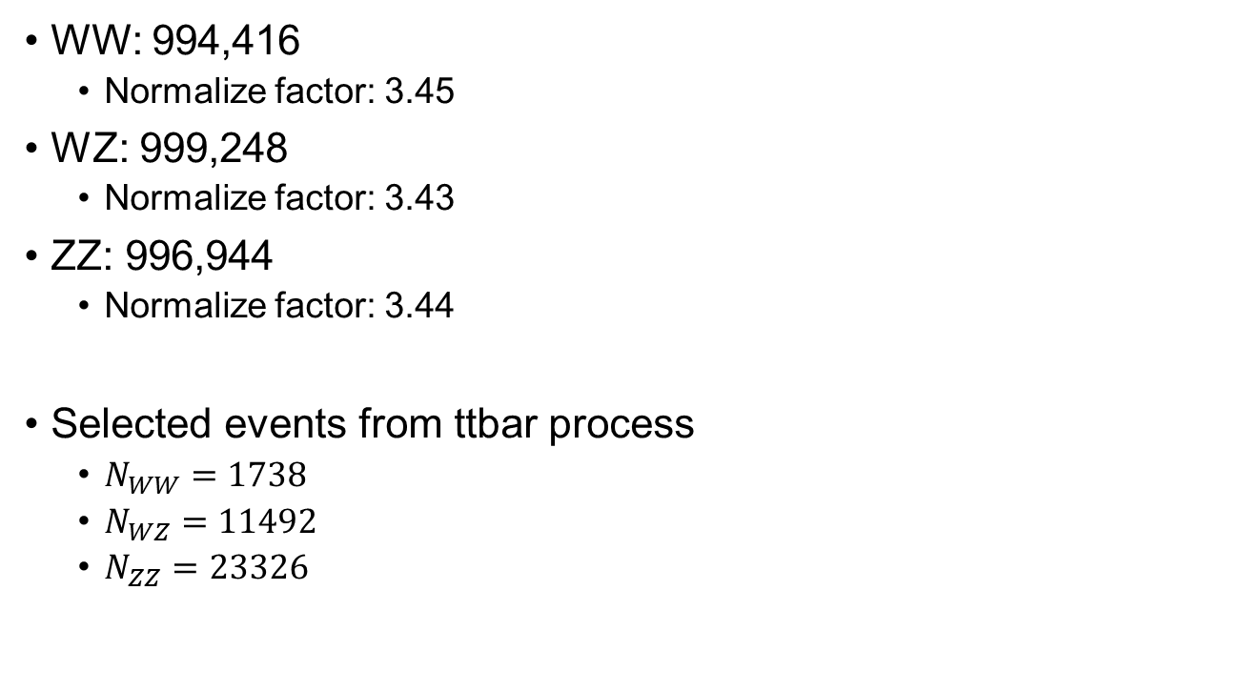
Diboson
WW: 994,416
Normalize factor: 3.45
WZ: 999,248
Normalize factor: 3.43
ZZ: 996,944
Normalize factor: 3.44
Selected events from ttbar process
$N_{WW}=1738$
$N_{WZ}=11492$
$N_{ZZ}=23326$

